Slide 1
Module - IV

Slide 2
Searching and Sorting
Both of these are techniques used to deal with data elements.
Searching refers to a technique that helps us search a data element out of the given string or array.
Sorting refers to the technique used for rearranging the data elements present in a string or an array in any specified order, descending or ascending.

Slide 3
Searching and Sorting
Searching
Linear search
Binary search
Sorting
Insertion Sort
Bubble sort
Selection Sort
Merge sort
Quick Sort
Heap sort
Radix sort
Bucket sort

Slide 4
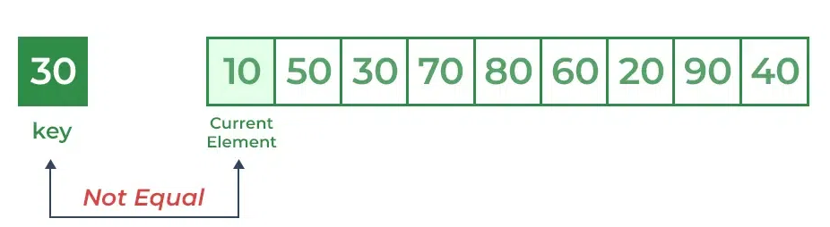
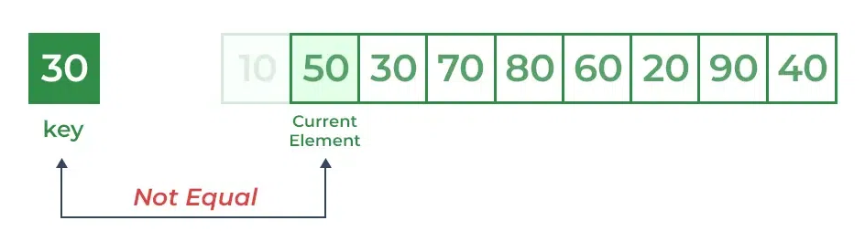
Linear search
Example
Consider the array arr[] = {10, 50, 30, 70, 80, 20, 90, 40} and key = 30
Step 1:
Step 2:
Step 3:

Slide 5
Linear search
Linear Search is defined as a sequential search algorithm
It starts at one end and goes through each element of a list until the desired element is found, otherwise the search continues till the end of the data set.
Working Method
Every element is considered as a potential match for the key and checked for the same.
If any element is found equal to the key, the search is successful and the index of that element is returned.
If no element is found equal to the key, the search yields “No match found”.

Slide 6
Linear search
procedure linear_search (list, value)
for each item in the list
if match item == value
return the item's location
end if
end for
end procedure
Linear Search ( Array A, Value x)
Step 1: Set i to 1
Step 2: if i > n then go to step 7
Step 3: if A[i] = x then go to step 6
Step 4: Set i to i + 1
Step 5: Go to Step 2
Step 6: Print Element x Found at index i and go to step 8
Step 7: Print element not found
Step 8: Exit

Slide 7
Linear search
Advantages of Linear Search:
Linear search can be used irrespective of whether the array is sorted or not. It can be used on arrays of any data type.
Does not require any additional memory.
It is a well-suited algorithm for small datasets.
Drawbacks of Linear Search:
Linear search has a time complexity of O(N), which in turn makes it slow for large datasets.
Not suitable for large arrays.

Slide 8
Binary search
Binary Search is defined as a searching algorithm used in a sorted array by repeatedly dividing the search interval in half.
The idea of binary search is to use the information that the array is sorted and reduce the time complexity.
Condition
The data structure must be sorted.

Slide 9
Binary Search Algorithm
Divide the search space into two halves by finding the middle index “mid”.
finding the middle index "mid" in Binary Search Algorithm
Finding the middle index “mid” in Binary Search Algorithm
Compare the middle element of the search space with the key.
If the key is found at middle element, the process is terminated.
If the key is not found at middle element, choose which half will be used as the next search space.
If the key is smaller than the middle element, then the left side is used for next search.
If the key is larger than the middle element, then the right side is used for next search.
This process is continued until the key is found or the total search space is exhausted.

Slide 10
Binary search
Can be implemented with a loop or recursively
Example:
Array : -4,2,7,10,15,20,22,30,36,42,50,56,68,85,92,103
Searching the array below for the value 42:
index | 0 | 1 | 2 | 3 | 4 | 5 | 6 | 7 | 8 | 9 | 10 | 11 | 12 | 13 | 14 | 15 | 16
value | -4 | 2 | 7 | 10 | 15 | 20 | 22 | 25 | 30 | 36 | 42 | 50 | 56 | 68 | 85 | 92 | 103
min
mid
max

Slide 11
Binary Search Algorithm
Binary_Search(a, lower_bound, upper_bound, val)
Step 1: set beg = lower_bound, end = upper_bound, pos = - 1
Step 2: repeat steps 3 and 4 while beg <=end
Step 3: set mid = (beg + end)/2
Step 4: if a[mid] = val
set pos = mid
print pos
go to step 6
else if a[mid] > val
set end = mid - 1
else
set beg = mid + 1
[end of if]
[end of loop]
Step 5: if pos = -1
print "value is not present in the array"
[end of if]
Step 6: exit

Slide 12
Binary Search Algorithm
Advantages of Binary Search:
Binary search is faster than linear search, especially for large arrays.
More efficient than other searching algorithms with a similar time complexity, such as interpolation search or exponential search.
Binary search is well-suited for searching large datasets that are stored in external memory, such as on a hard drive or in the cloud.
Drawbacks of Binary Search:
The array should be sorted.
Binary search requires that the data structure being searched be stored in contiguous memory locations.

Slide 13
Sorting Algorithms
A Sorting Algorithm is used to rearrange a given array or list of elements according to a comparison operator on the elements.
The comparison operator is used to decide the new order of elements in the respective data structure.
Insertion Sort
Bubble sort
Selection Sort
Merge sort
Quick Sort
Heap sort
Radix sort
Bucket sort

Slide 14
Insertion Sort
Idea: like sorting a hand of playing cards
Start with an empty left hand and the cards facing down on the table.
Remove one card at a time from the table, and insert it into the correct position in the left hand
compare it with each of the cards already in the hand, from right to left
The cards held in the left hand are sorted
these cards were originally the top cards of the pile on the table

Slide 15
Insertion Sort
To insert 12, we need to make room for it by moving first 36 and then 24.
6
10
24
36
12

Slide 16
Insertion Sort
6
10
24
36
12

Slide 17
Insertion Sort
6
10
24
36
12

Slide 18
Insertion Sort
10
12
24
6
36

Slide 19
Insertion Sort
input array
5 2 4 6 1 3
at each iteration, the array is divided in two sub-arrays:
left sub-array
right sub-array
sorted
unsorted

Slide 20
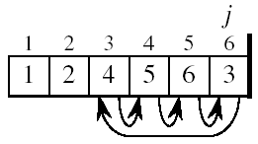
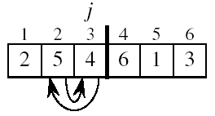
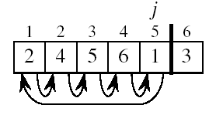
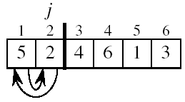
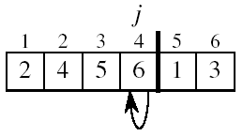
Insertion Sort

Slide 21
Insertion Sort Algorithm
Step 1 - If the element is the first element, assume that it is already sorted. Return 1.
Step2 - Pick the next element, and store it separately in a key.
Step3 - Now, compare the key with all elements in the sorted array.
Step 4 - If the element in the sorted array is smaller than the current element, then move to the next element. Else, shift greater elements in the array towards the right.
Step 5 - Insert the value.
Step 6 - Repeat until the array is sorted.
Characteristics of Insertion Sort
This algorithm is one of the simplest algorithms with a simple implementation
Basically, Insertion sort is efficient for small data values
Insertion sort is adaptive in nature, i.e. it is appropriate for data sets that are already partially sorted.

Slide 22
Bubble Sort
Bubble Sort is the simplest sorting algorithm that works by repeatedly swapping the adjacent elements if they are in the wrong order.
This algorithm is not suitable for large data sets as its average and worst-case time complexity is quite high.
Working
traverse from left and compare adjacent elements and the higher one is placed at right side.
In this way, the largest element is moved to the rightmost end at first.
This process is then continued to find the second largest and place it and so on until the data is sorted.

Slide 23
Bubble Sort Algorithm
Step1: start
Step2: Input the array A[n]
Step3: [Compute the sorting]
Repeat For I←0 to n-1
Step4: [Compare the adjacent elements]
Repeat For J←0 to n-1-I
Step5: If (A[J]>A[J+1])
[Interchange A[J] and A[J+1]]
Temp←A[J]
A[J] ←A[J+1]
A[J+1] ←temp
[End If]
[End step3 for loop]
[End step4 for loop]
Step6: [Display output]
Repeat For I←0 to n-1
Output A[I]
[End for]
Step9: stop

Slide 24
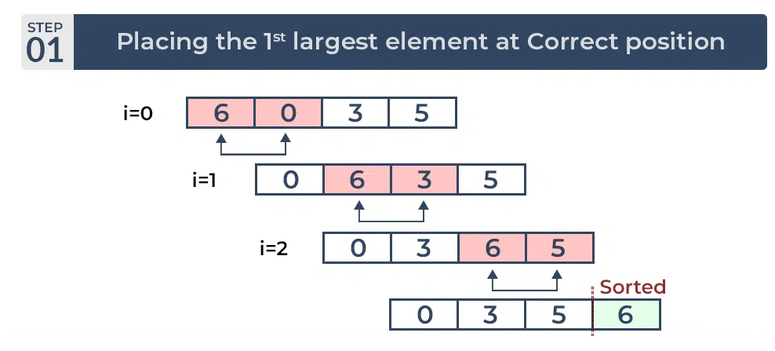

Bubble Sort Example
Input Array = { 6,0,3,5}

Slide 25
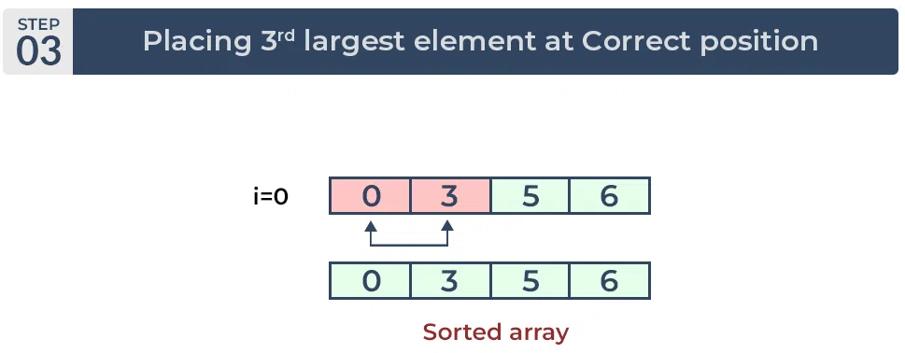
Bubble Sort Example
Advantages:
Simple to understand and implement.
Very straight forward.
Better than selection sort.
Disadvantages:
It runs slowly and hence it is not efficient, because more efficient sorting techniques are available.
Even if array is sorted, n-1 comparisons are required.

Slide 26
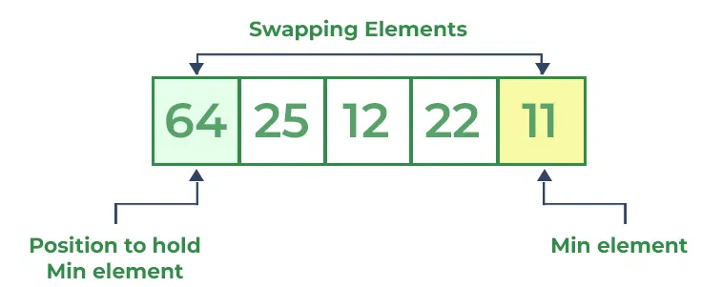
Selection Sort
Selection sort is a simple and efficient sorting algorithm that works by repeatedly selecting the smallest (or largest) element from the unsorted portion of the list and moving it to the sorted portion of the list.
Lets consider the following array as an example: arr[] = {64, 25, 12, 22, 11}
First pass:
For the first position in the sorted array, the whole array is traversed from index 0 to 4 sequentially. The first position where 64 is stored presently, after traversing whole array it is clear that 11 is the lowest value.
Thus, replace 64 with 11. After one iteration 11, which happens to be the least value in the array, tends to appear in the first position of the sorted list.

Slide 27
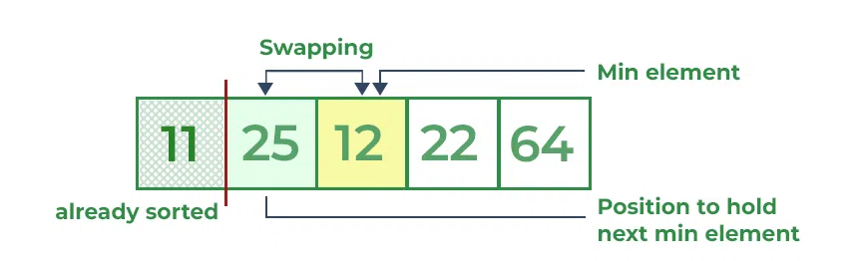
Selection Sort
Second Pass:
For the second position, where 25 is present, again traverse the rest of the array in a sequential manner.
After traversing, we found that 12 is the second lowest value in the array and it should appear at the second place in the array, thus swap these values

Slide 28
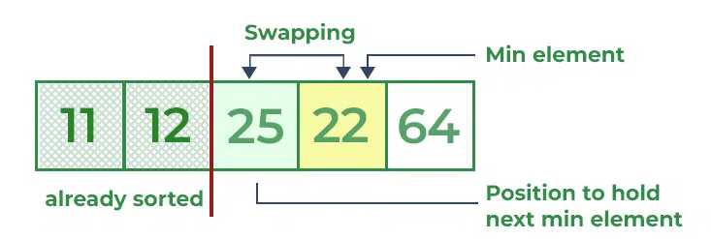
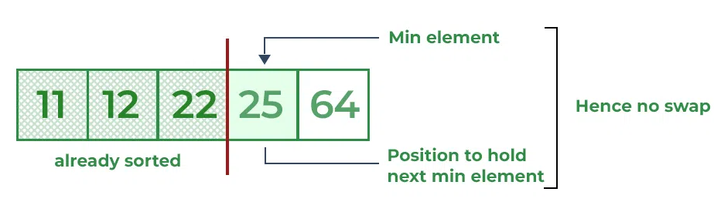
Selection Sort
Third Pass
Fourth Pass
Fifth Pass

Slide 29
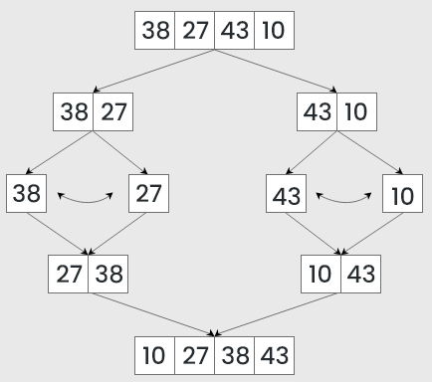
Merge Sort
Merge sort is defined as a sorting algorithm that works by dividing an array into smaller subarrays, sorting each subarray, and then merging the sorted subarrays back together to form the final sorted array.
The process of merge sort is to divide the array into two halves, sort each half, and then merge the sorted halves back together.
This process is repeated until the entire array is sorted.

Slide 30
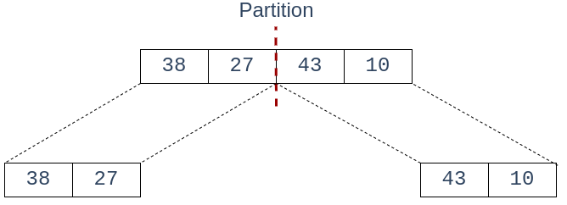
Merge Sort
Lets consider an array arr[] = {38, 27, 43, 10}
Initially divide the array into two equal halves
Step 1:

Slide 31
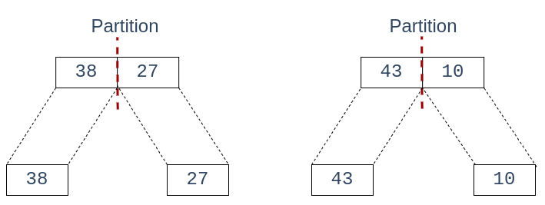

Merge Sort
Step 2:
Step 3:

Slide 32
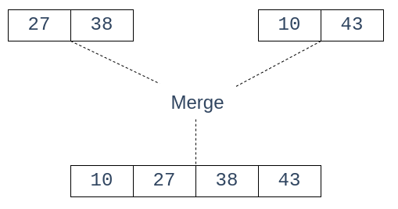
Merge Sort
Step 4:
The following diagram shows the complete merge sort process for an example array {38, 27, 43, 3, 9, 82, 10}.
Algorithm
MERGE_SORT(arr, beg, end)
if beg < end
set mid = (beg + end)/2
MERGE_SORT(arr, beg, mid)
MERGE_SORT(arr, mid + 1, end)
MERGE (arr, beg, mid, end)
end of if
END MERGE_SORT

Slide 33
Quick Sort
Quick Sort is a sorting algorithm based on the Divide and Conquer algorithm that picks an element as a pivot and partitions the given array around the picked pivot by placing the pivot in its correct position in the sorted array.
The key process in quick Sort is a partition(). The target of partitions is to place the pivot (any element can be chosen to be a pivot) at its correct position in the sorted array and put all smaller elements to the left of the pivot, and all greater elements to the right of the pivot.
Pivot Choice
Always pick the first element as a pivot.
Always pick the last element as a pivot
Pick a random element as a pivot.
Pick the middle as the pivot.

Slide 34
Quick Sort
Lets consider an array arr[] = {10,16,8,12,15,6,3,9,5}
Sorted – 3,5,6,8,9,10,12,15,16
Step 1: 10,16,8,12,15,6,3,9,5
Pi i j
Step 2: i< Pi && j> pi else Swap
Pi i j
10 | 16 | 8 | 12 | 15 | 6 | 3 | 9 | 5
10 | 5 | 8 | 12 | 15 | 6 | 3 | 9 | 16

Slide 35
Quick Sort
Step 3:
Pi i j
Step 5:
Pi i j
Swap
Step 6:
Pi i j
10 | 16 | 8 | 12 | 15 | 6 | 3 | 9 | 5
10 | 5 | 8 | 12 | 15 | 6 | 3 | 9 | 16
10 | 5 | 8 | 9 | 15 | 6 | 3 | 12 | 16

Slide 36
Quick Sort
Step 7: Swap
Pi i j
Pivot Placed here
10 | 5 | 8 | 9 | 3 | 6 | 15 | 12 | 16
5 | 8 | 9 | 3 | 6 | 10 | 15 | 12 | 16

Slide 37
Quick Sort
Advantages of Quick Sort:
It is a divide-and-conquer algorithm that makes it easier to solve problems.
It is efficient on large data sets.
It has a low overhead, as it only requires a small amount of memory to function.
Disadvantages of Quick Sort:
It has a worst-case time complexity of O(N2), which occurs when the pivot is chosen poorly.
It is not a good choice for small data sets.
It is not a stable sort, meaning that if two elements have the same key, their relative order will not be preserved in the sorted output in case of quick sort, because here we are swapping elements according to the pivot’s position (without considering their original positions).

Slide 38
Heap Sort
Heap sort is a comparison-based sorting technique based on Binary Heap data structure. It is similar to the selection sort where we first find the minimum element and place the minimum element at the beginning. Repeat the same process for the remaining elements.
Working
Build a heap from the given input array.
Repeat the following steps until the heap contains only one element:
Swap the root element of the heap (which is the largest element) with the last element of the heap.
Remove the last element of the heap (which is now in the correct position).
Heapify the remaining elements of the heap.
The sorted array is obtained by reversing the order of the elements in the input array.

Slide 39
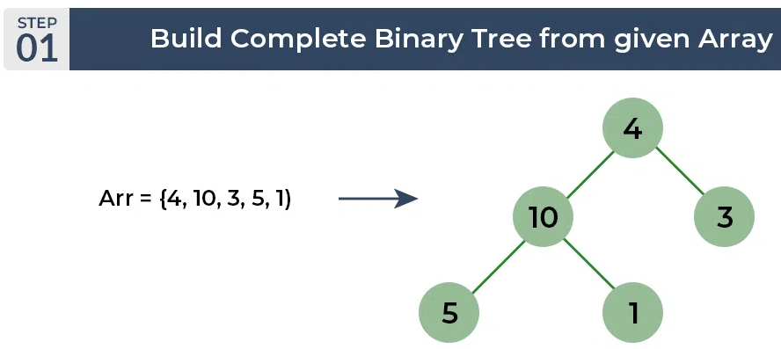
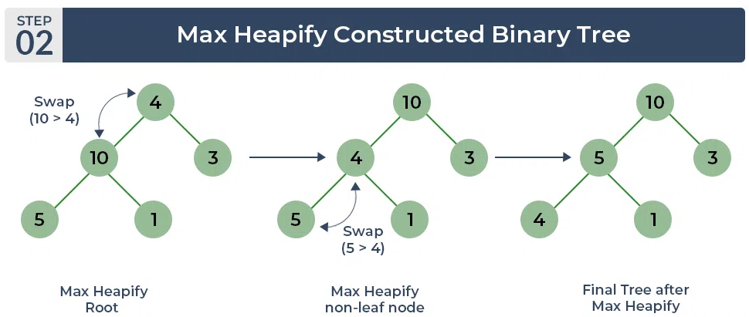
Heap Sort
Consider the array: arr[] = {4, 10, 3, 5, 1}.

Slide 40
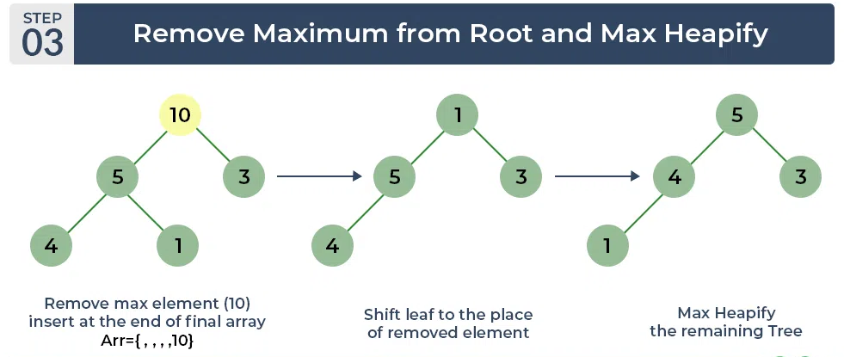
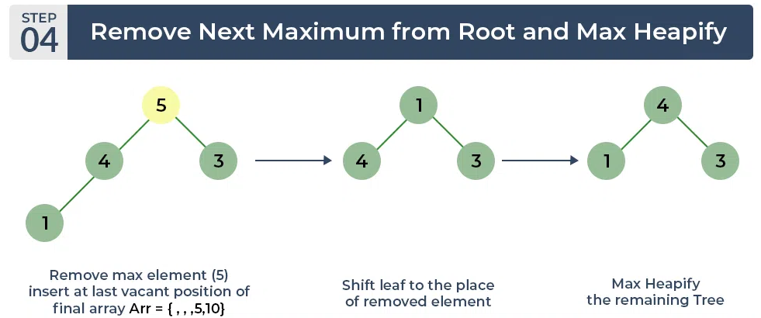
Heap Sort

Slide 41
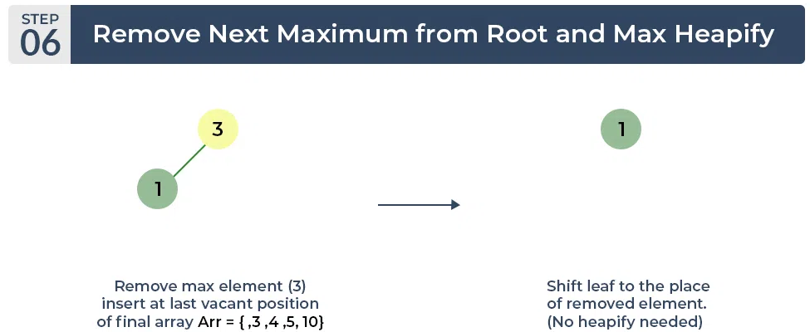
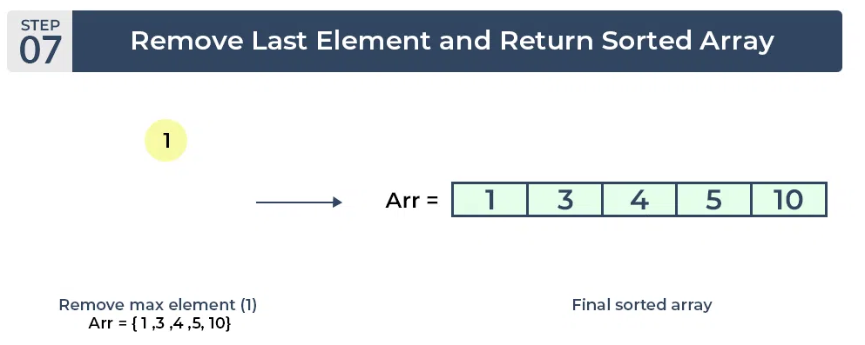
Heap Sort

Slide 42
Heap Sort
Advantages of Heap Sort:
Efficient Time Complexity: Heap Sort has a time complexity of O(n log n) in all cases. This makes it efficient for sorting large datasets. The log n factor comes from the height of the binary heap, and it ensures that the algorithm maintains good performance even with a large number of elements.
Memory Usage – Memory usage can be minimal because apart from what is necessary to hold the initial list of items to be sorted, it needs no additional memory space to work
Simplicity – It is simpler to understand than other equally efficient sorting algorithms because it does not use advanced computer science concepts such as recursion.
Disadvantages of Heap Sort:
Costly: Heap sort is costly.
Unstable: Heap sort is unstable. It might rearrange the relative order.
Efficient: Heap Sort is not very efficient when working with highly complex data.

Slide 43
Radix Sort
Radix Sort is a linear sorting algorithm that sorts elements by processing them digit by digit. It is an efficient sorting algorithm for integers or strings with fixed-size keys.
The key idea behind Radix Sort is to exploit the concept of place value. It assumes that sorting numbers digit by digit will eventually result in a fully sorted list.
Radix Sort can be performed using different variations, such as Least Significant Digit (LSD) Radix Sort or Most Significant Digit (MSD) Radix Sort.

Slide 44
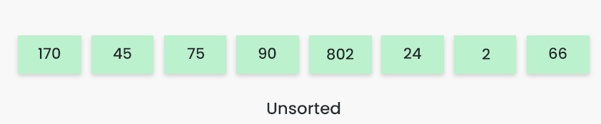
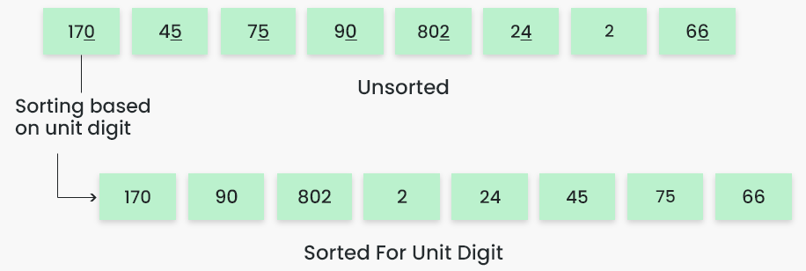
Radix Sort
To perform radix sort on the array [170, 45, 75, 90, 802, 24, 2, 66],
follow these steps:
Step 1 :

Slide 45
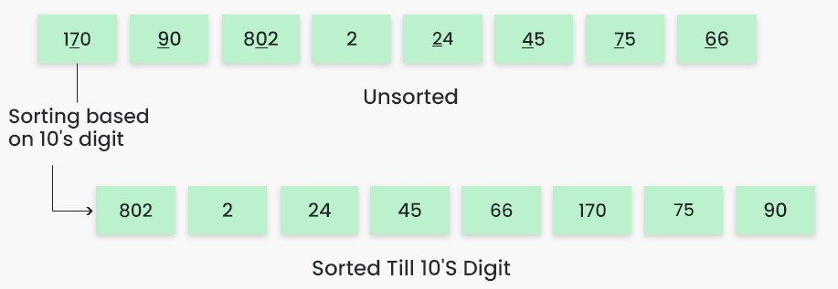
Radix Sort
Step 3 :
The sorted array based on the tens place is [802, 2, 24, 45, 66, 170, 75, 90].

Slide 46
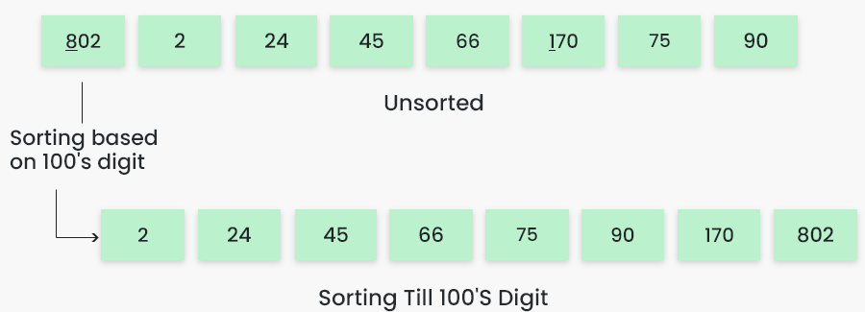
Radix Sort
Step 4 :
The sorted array based on the hundreds place is [2, 24, 45, 66, 75, 90, 170, 802].

Slide 47
Bucket Sort
Bucket sort is a sorting technique that involves dividing elements into various groups, or buckets.
These buckets are formed by uniformly distributing the elements.
Once the elements are divided into buckets, they can be sorted using any other sorting algorithm.
Finally, the sorted elements are gathered together in an ordered fashion.

Slide 48
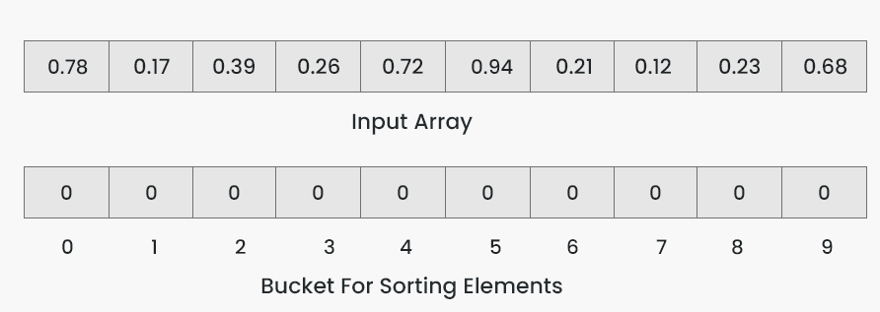
Bucket Sort
To apply bucket sort on the input array [0.78, 0.17, 0.39, 0.26, 0.72, 0.94, 0.21, 0.12, 0.23, 0.68],
Follow these steps
Step 1

Slide 49
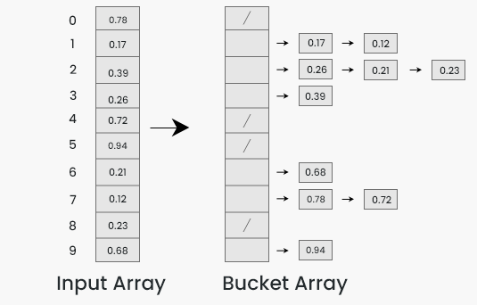
Bucket Sort
Step 2: Insert elements into the buckets from the input array based on their range.
Inserting elements into the buckets:
Take each element from the input array.
Multiply the element by the size of the bucket array (10 in this case). For example, for element 0.23, we get 0.23 * 10 = 2.3.

Slide 50
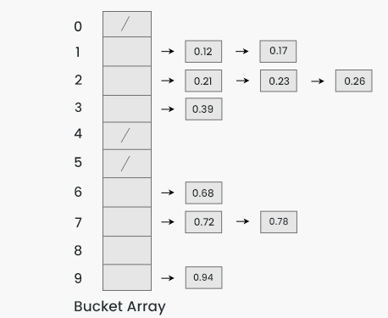
Bucket Sort
Step 3: Sort the elements within each bucket. In this example, we use quicksort (or any stable sorting algorithm) to sort the elements within each bucket.
Sorting the elements within each bucket:
Apply a stable sorting algorithm (e.g., quicksort) to sort the elements within each bucket.
The elements within each bucket are now sorted

Slide 51
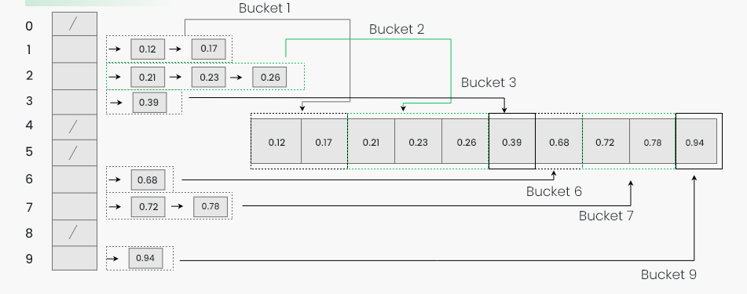
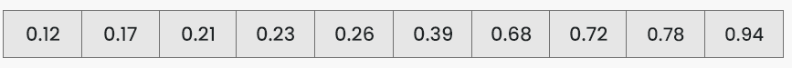
Bucket Sort
Step 4: Gather the elements from each bucket and put them back into the original array.
Sorted Array

Slide 52
Algorithm Design Techniques
An Algorithm is a procedure to solve a particular problem in a finite number of steps for a finite-sized input.
The algorithms can be classified in various ways. They are:
Implementation Method
Design Method
Design Approaches
Other Classifications
The classification of algorithms is important for several reasons
Problem Solving
Performance Comparison
Reusability
Research

Slide 53
Implementation Method
Recursion or Iteration: A recursive algorithm is an algorithm which calls itself again and again until a base condition is achieved whereas iterative algorithms use loops and/or data structures like stacks, queues to solve any problem.
Exact or Approximate: Algorithms that are capable of finding an optimal solution for any problem are known as the exact algorithm. where it is not possible to find the most optimized solution, an approximation algorithm is used.
Serial or Parallel or Distributed Algorithms: In serial algorithms, one instruction is executed at a time while parallel algorithms are those in which we divide the problem into subproblems and execute them on different processors. If parallel algorithms are distributed on different machines, then they are known as distributed algorithms.

Slide 54
Classification by Design Approaches
Top-Down Approach
Bottom-up approach
Top-Down Approach: In the top-down approach, a large problem is divided into small sub-problem. and keep repeating the process of decomposing problems until the complex problem is solved.
Bottom-up approach: The bottom-up approach is also known as the reverse of top-down approaches.
In approach different, part of a complex program is solved using a programming language and then this is combined into a complete program.

Slide 55
Classification by Design Method
Greedy Method: In the greedy method, at each step, a decision is made to choose the local optimum, without thinking about the future consequences.
Example: Fractional Knapsack, Activity Selection.
Divide and Conquer: The Divide and Conquer strategy involves dividing the problem into sub-problem, recursively solving them, and then recombining them for the final answer.
Example: Merge sort, Quicksort.
Dynamic Programming: The approach of Dynamic programming is similar to divide and conquer. The difference is that whenever we have recursive function calls with the same result, instead of calling them again we try to store the result in a data structure in the form of a table and retrieve the results from the table.
Example: 0-1 Knapsack, subset-sum problem.

